Slide 1
Section 4.5 Estimating Points on a Line:

Slide 2
Estimating Points on a Line:
When given a line segment, we can use the “x” coordinate to find the corresponding “y” coordinate
Suppose you have a line:
y
When “x” is equal to 4, we can find the corresponding “y” value by going straight up to the line
7
6
5
4
After it hits the line, go horizontally to the Y-axis to the corresponding y-value
3
2
1
When “x” is equal to 4, the “y” value is equal to 5
x
0
1
2
3
4
5
6
7

Slide 3
Practice: The following graph shows the cost of a Taxi ride as a function of time. Use the graph to answer the following questions:
How much is the cost when the taxi ride is 30 min long?
y
80
70
How much is the cost when the taxi ride is 40 min long?
60
50
Cost ($)
40
If you only had $60, how long can you ride the taxi?
30
20
How much does it cost at the beginning?
10
x
0
5
10
15
20
25
30
35
40
Time (min)
© Copyright all rights reserved to Homework depot: www.BCMath.ca

Slide 4
Interpolation vs Extrapolation :
Interpolation means that you are estimating the value of a point within the data points of your graph
Extrapolation means that you are estimating the value of a point outside the data points of your graph
Suppose you have a bunch of points but not enough to have a line yet
Extrapolation is estimating a point outside of your data points
y
7
Interpolation is estimating a point that is missing within your data
6
Extend the line and keep the slope consistent
5
So you make a line and estimate that point
4
Extrapolation can be used to predict future values or data that you don’t have
3
So when “x” is 4, the value of “y” is 3
2
1
So when “x” is 7.4, the value of “y” is around 4.75
x
0
1
2
3
4
5
6
7

Slide 5
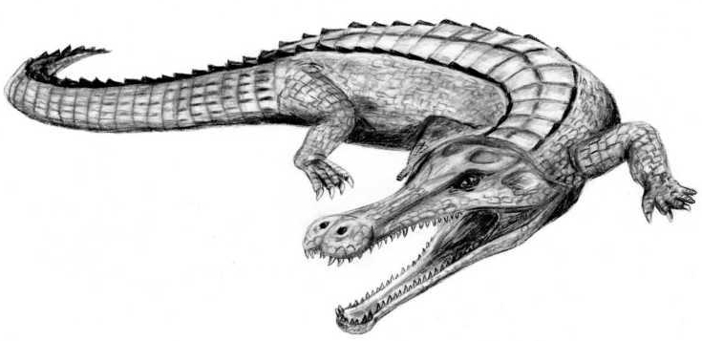
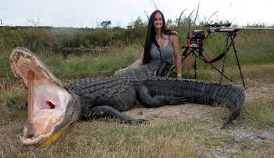
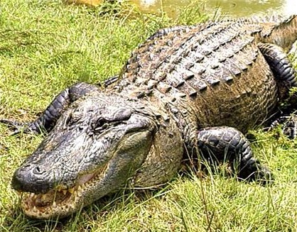
Practice: The length of an adult crocodile can range from 1meter to 6.2meters long. Scientists have associated the jaw length to be in ratio with the full length of an crocodile. Using this information, scientist have predicted the length of a SuperCroc that lived 110million years ago. If the jaw length of a SuperCroc is 1.8m long, use the graph the predict its length:

Slide 6
y
Q: What is the full length of a super croc with a jaw length of 1.8m?
13
12
11
10
9
8
Q: What is the jaw length of a crocodile that is 6m long?
7
Full Length of Alligator
6
5
4
3
Q: What is the jaw length of a crocodile that is 6m long?
2
1
x
0
0.2
0.4
0.6
0.8
1
1.2
1.4
1.6
1.8
2
2.2
Jaw Length of Crocodile

Slide 7
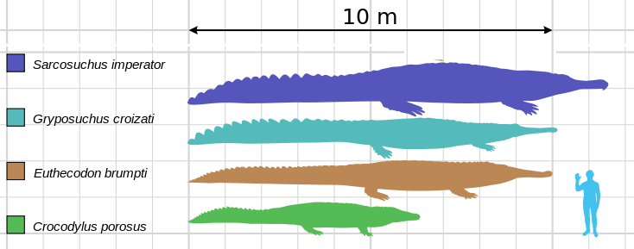

Slide 8
HW:
P196: # 4 – 11, 13

